Slide 1
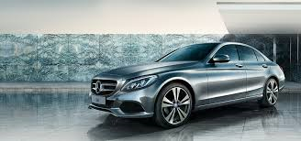


Car Sales Data – Exploratory Analysis
Ramlal Arya
https://github.com/ramlalarya
www.linkedin.com/in/ramlal-arya-8b90a069

Slide 2
EDA – About the Data
This dataset was collected from car sale advertisements for study/practice purposes in 2016. This dataset contains data for more than 9.5K cars sale in Ukraine.”
Data Source:
https://raw.githubusercontent.com/insaid2018/Term-1/
master/Data/Projects/car_sales.csv
Data Volume:
It contains 9576 records and 10 variables
Attribute Information
1. car : Manufacturer / Brand (87 unique values)
2. price : Seller’s price in advertisement (in USD)
3. body : Car body type (6 unique values – Sedan, Crossover, Hatch,
Van, Vagon and Other)
4. mileage : Mileage of car miles / kilometer (‘000 Km)
5. engV : Rounded engine volume (‘000 cubic cm)
6. engType : Type of fuel (4 unique values – Petrol, Diesel, Gas and Other)
7. registration : Whether car registered in Ukraine or not
8. year : Year of production
9. model : Specific model name
10. drive : Drive type (3 unique values – Front, Rear and Full)

Slide 3
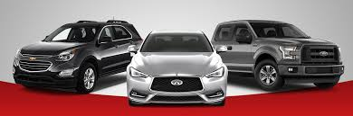
EDA - Car Sales Data
Total 201 rows were duplicate in this dataset, so we had removed these duplicate records.
“Model” column was deleted from dataset due to high cardinality.
Zero values of “Price” and “Mileage” columns were replaced with mean group by “Brand”
NaN values of “engine volume (engV)” was replaced with mean and NaN values of “Drive” was replaced with mode.

Slide 4
EDA – Problem Statement
“ Need to explore the available dataset and try to discover some important facts about data”.
Need to find some useful patterns in data
Want to establish relationships between existing variables
Need to identify some questions from available data and try to find best answers of those questions with the help of data analysis.

Slide 5
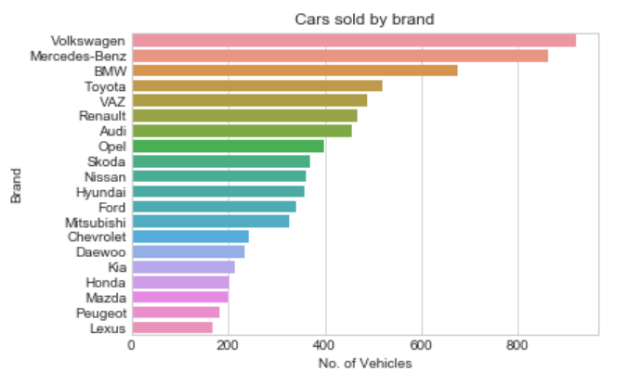
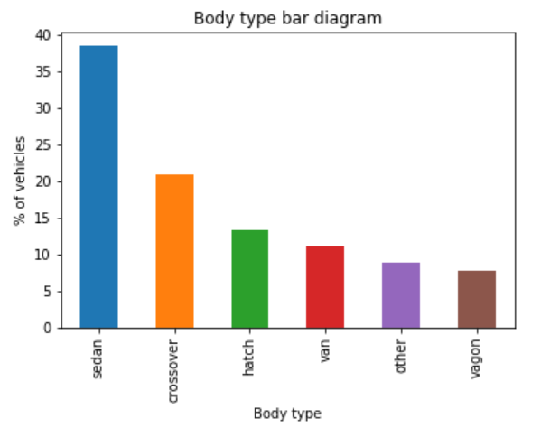
EDA – Data Analysis
Cars sold by Brand & Body type
Highest cars sold by “Volkswagen” followed by “Mercedes-Benz” and “BMW”.
Approx. 38% of total cars sold with “Sedan” body type followed by 21% with “Crossover” and 14% with “Hatch” body type.

Slide 6
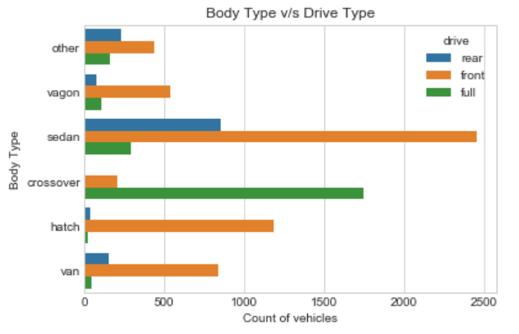
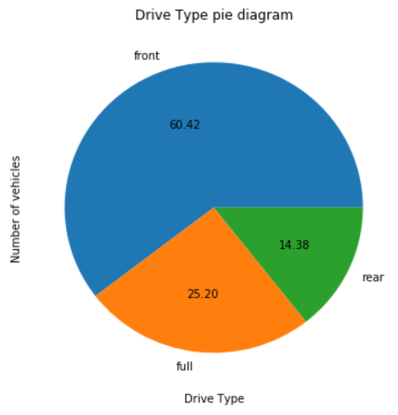
EDA – Data Analysis
Cars sold by Drive Type & Body Type
Highest cars sold in “Front” wheel drive category which is approx. 61% of total cars.
“Front” wheel drive cars are the top most in all body type except in “Crossover” body type.
“Full” wheel drive cars are leading in “Crossover” body type.

Slide 7
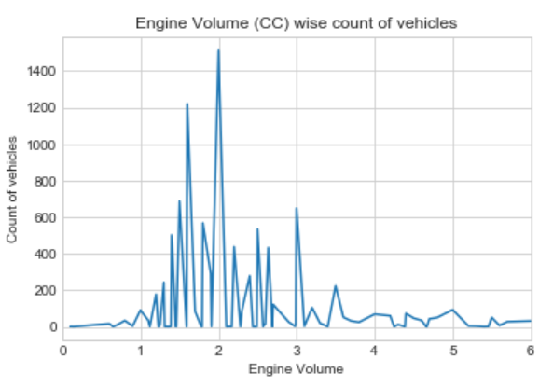
EDA – Data Analysis
Cars sold by Engine Volume
Highest number of cars sold in 2.0 Engine Volume segment, followed by 1.5 engine volume segment.
There are very few cars sold below 1.0 and above 4.0 engine volume segment.

Slide 8
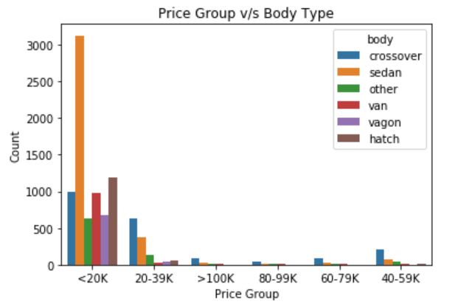
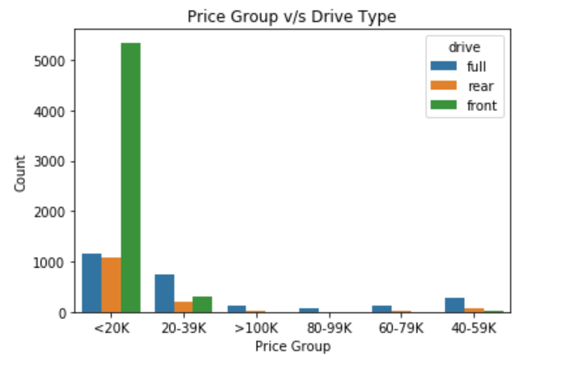
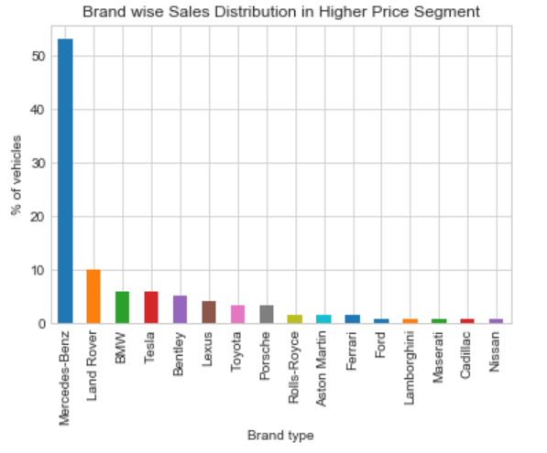
EDA – Data Analysis
Relation of Price with Body Type, Drive Type and Brand
Highest number of cars sold in price range of < = $ 20K with Front wheel drive type and Sedan body type.
“Mercedes-Benz” is leading brand in higher price segement cars.

Slide 9
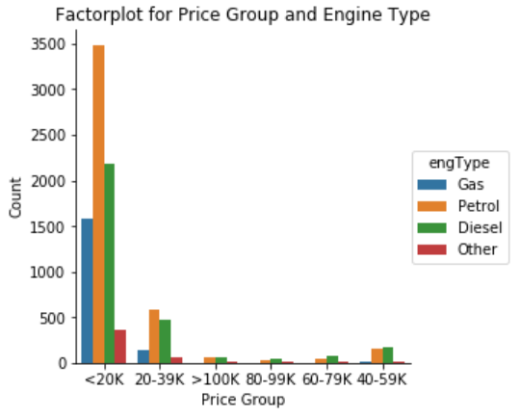
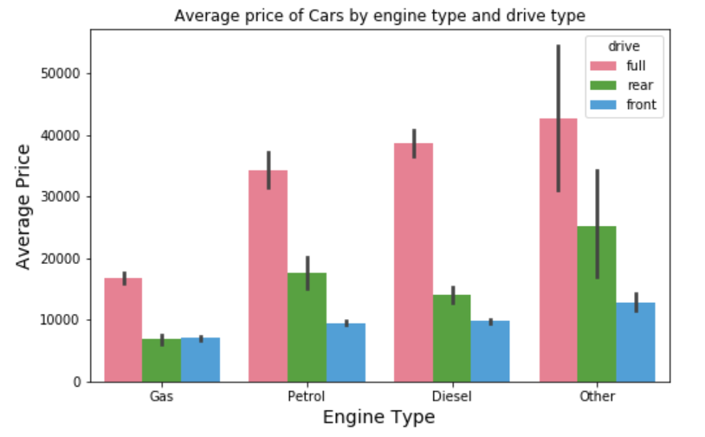
EDA – Data Analysis
Cars sold by Engine Type (engType)
Highest number of cars sold with “Petrol” engine type in the price range of < = $ 20K.
In higher price segment “Diesel” engine type cars are leading compare to other engine type.
All engine types of cars have more average price for full wheel drive type cars compare to other drive type .

Slide 10
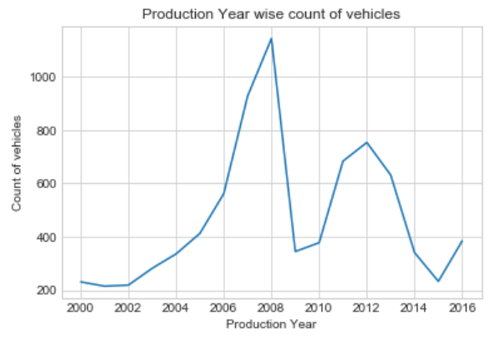
EDA – Data Analysis
Cars sold by Production Year
Production year 2008 and 2012 cars are highest number of cars sold.

Slide 11
EDA – Conclusion
80% of total cars sold in the price below $ 20K with body type as "Sedan", drive type as "Front" and engine type as "Petrol", because the middle class families preferred low price cars with Sedan body and Petrol engine type.
"Mercedes-Benz" is the leading brand in higher price segment cars.
Majority of the higher price range cars sold with body type as "Crossover", drive type as "Full" and engine type as "Diesel".
Most of the cars sold in 2.0 engine volume segment followed by 1.5, there are very few cars sold below 1.0 and above 4.0 engine volume segment.
We have also observed that lower price segment car has higher mileage and higher price segment car has lower mileage.
Production year 2008 and 2012 cars are the highest sold cars
Price has positive correlation with engine volume and production year and negatively correlation with mileage.
Production year has negative correlation with mileage and engine volume.

Slide 12
Thank You
Python Notebooks used for analysis on Github:
https://github.com/ramlalarya/EDA-Car_Sales_Data

